Slide 1
One Way Hash Function
This lecture is mainly based on the power point slides by Professor Lawrie Brown.
Notes:
Zili Shao

Slide 2
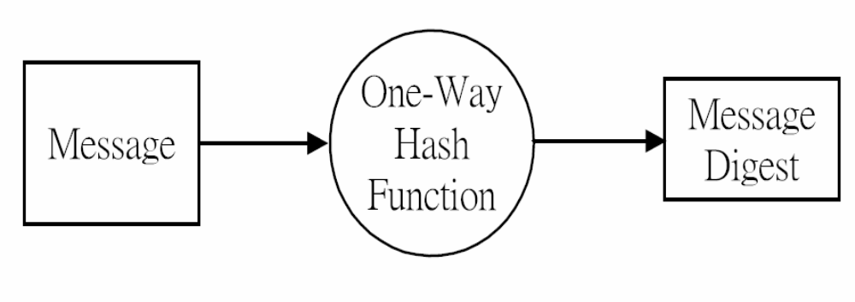
Hash and Message Digest
CEG 260, Meilin Liu
Notes:
Zili Shao
All security policies and mechanisms rest on assumptions; we’ll examine some in later chapters, most notably Chapter 22, Malicious Logic. Here is a taste of the assumptions.
Policies: as these define security, they have to define security correctly for the particular site. For example, a web site has to be available, but if the security policy does not mention availability, the definition of security is inappropriate for the site. Also, a policy may not specify whether a particular state is “secure” or “non-secure.” This ambiguity causes problems.
Mechanisms: as these enforce policy, they must be appropriate. For example, cryptography does not assure availability, so using cryptography in the above situation won’t work. Further, security mechanisms rely on supporting infrastructure, such as compilers, libraries, the hardware, and networks to work correctly. Ken Thompson’s modified C preprocessor (see the example on p. 615) illustrates this point very well.

Slide 3
Hash Functions
condenses arbitrary message to fixed size
  h = H(M)
usually assume that the hash function is public and not keyed
  MAC which is keyed
hash used to detect changes to message
can use in various ways with message
most often to create a digital signature
CEG 260, Meilin Liu
Notes:
Zili Shao
A variation on the message authentication code is the one-way hash function. As with the message authentication code, a hash function accepts a variable-size message M as input and produces a fixed-size output, referred to as a hash code H(M). Unlike a MAC, a hash code does not use a key but is a function only of the input message. The hash code is also referred to as a message digest or hash value.

Slide 4
Requirements for Hash Functions
can be applied to any sized message M
produces fixed-length output h
is easy to compute h=H(M) for any message M
given h is infeasible to find x s.t. H(x)=h
  one-way property
given x is infeasible to find y s.t. H(y)=H(x)
  weak collision resistance
is infeasible to find any x,y s.t. H(y)=H(x)
  strong collision resistance
CEG 260, Meilin Liu
Notes:
Zili Shao
These are the specifications for good hash functions. Essentially it must be extremely difficult to find 2 messages with the same hash, and the hash should not be related to the message in any obvious way (ie it should be a complex non-linear function of the message). There are quite a few similarities in the evolution of hash functions & block ciphers, and in the evolution of the design requirements on both.

Slide 5
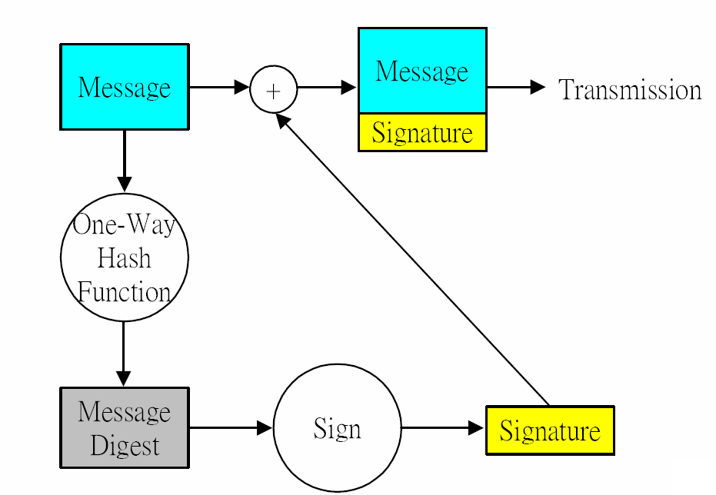
Message Digest and Signature
CEG 260, Meilin Liu
Notes:
Zili Shao
The actual key exchange for either party consists of raising the others "public key' to power of their private key. The resulting number (or as much of as is necessary) is used as the key for a block cipher or other private key scheme. For an attacker to obtain the same value they need at least one of the secret numbers, which means solving a discrete log, which is computationally infeasible given large enough numbers

Slide 6
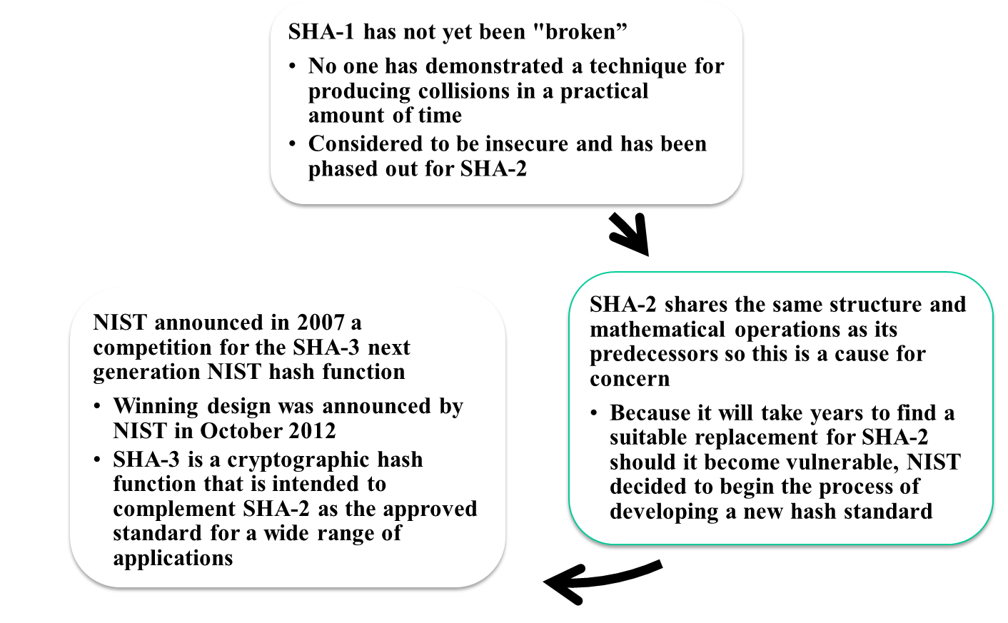
SHA-3
Notes:
As of this writing, the Secure Hash Algorithm (SHA-1) has not yet been “broken.”
That is, no one has demonstrated a technique for producing collisions in a practical
amount of time. However, because SHA-1 is very similar, in structure and in the
basic mathematical operations used, to MD5 and SHA-0, both of which have been
broken, SHA-1 is considered insecure and has been phased out for SHA-2.
SHA-2, particularly the 512-bit version, would appear to provide unassailable
security. However, SHA-2 shares the same structure and mathematical operations
as its predecessors, and this is a cause for concern. Because it will take years to find
a suitable replacement for SHA-2, should it become vulnerable, NIST decided to
begin the process of developing a new hash standard.
Accordingly, NIST announced in 2007 a competition to produce the next generation
NIST hash function, to be called SHA-3. The winning design for SHA-3
was announced by NIST in October 2012. SHA-3 is a cryptographic hash function
that is intended to complement SHA-2 as the approved standard for a wide range
of applications.
Appendix V looks at the evaluation criteria used by NIST to select from
among the candidates for AES, plus the rationale for picking Keccak, which was
the winning candidate. This material is useful in understanding not just the SHA-3
design but also the criteria by which to judge any cryptographic hash algorithm.

Slide 7
The SHA-3 Competition
First round: October 2008 to summer 2009
  64 submissions, 51 accepted 37
  presented at 1st SHA-3 candidate conf. in Leuven, February 2009 many broken by cryptanalysis
  NIST narrowed down to 14 semi-ﬁnalists
Second round: summer 2009 to autumn 2010
  analysis presented at 2nd SHA-3 conf. in Santa Barbara, August 2010
  NIST narrowed down to 5 ﬁnalists
Third round: autumn 2010 to October 2012
  analysis presented at 3rd SHA-3 conf. in Washington, March 2012
October 2, 2012: NIST announces Keccak as SHA-3 winner
Notes:
The underlying structure of SHA-3 is a scheme referred to by its designers as a
sponge construction [BERT07, BERT11]. The sponge construction has the same
general structure as other iterated hash functions (Figure 11.8). The sponge function
takes an input message and partitions it into fixed-size blocks. Each block is
processed in turn with the output of each iteration fed into the next iteration, finally
producing an output block.
The sponge function is defined by three parameters:
f = the internal function used to process each input block
r = the size in bits of the input blocks, called the bitrate
pad = the padding algorithm

Slide 8
The Sponge Construction
Underlying structure of SHA-3 is a scheme referred to by its designers as a sponge construction
Takes an input message and partitions it into fixed-size blocks
Each block is processed in turn with the output of each iteration fed into the next iteration, finally producing an output block
The sponge function is defined by three parameters:
  f = the internal function used to process each input block
  r = the size in bits of the input blocks, called the bitrate
  pad = the padding algorithm
Notes:
The underlying structure of SHA-3 is a scheme referred to by its designers as a
sponge construction [BERT07, BERT11]. The sponge construction has the same
general structure as other iterated hash functions (Figure 11.8). The sponge function
takes an input message and partitions it into fixed-size blocks. Each block is
processed in turn with the output of each iteration fed into the next iteration, finally
producing an output block.
The sponge function is defined by three parameters:
f = the internal function used to process each input block
r = the size in bits of the input blocks, called the bitrate
pad = the padding algorithm

Slide 9
Kaccak Function
Sponge function using the permutation Keccak-f
  State b =25*2^l, l= 0, 1, …… , 6
  7 permutations: b∈{25,50,100,200,400,800,1600} …
  # of rounds = 12 + 2*l = 12 + 2*6 = 24
SHA-3 instance: r = 1088 and c = 512
  permutation width: 1600
  security strength 256: post-quantum suﬃcient
Notes:
The underlying structure of SHA-3 is a scheme referred to by its designers as a
sponge construction [BERT07, BERT11]. The sponge construction has the same
general structure as other iterated hash functions (Figure 11.8). The sponge function
takes an input message and partitions it into fixed-size blocks. Each block is
processed in turn with the output of each iteration fed into the next iteration, finally
producing an output block.
The sponge function is defined by three parameters:
f = the internal function used to process each input block
r = the size in bits of the input blocks, called the bitrate
pad = the padding algorithm

Slide 10
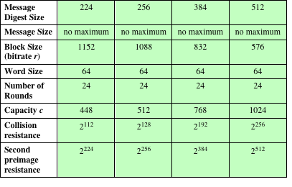
Table 11.5
SHA-3 Parameters
Notes:
Table 11.5 shows
the supported values of r and c . As Table 11.5 shows, the hash function security associated
with the sponge construction is a function of the capacity c .

Slide 11
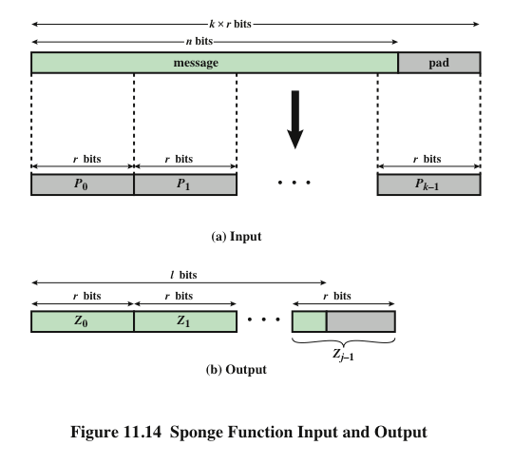
Simple padding is denoted by 10*
Simple padding appends a single bit 1 followed by the minimum number of 0s
such that the length of the result is a multiple of the block length.
Multi-rate padding is denoted by 10*1
Multi-rate padding appends a single bit 1 followed by the minimum number of 0s followed by a single bit 1 such that the length of the result is a multiple of the block length. – FIPS 202
Notes:
A sponge function allows both variable length input and output, making it a
flexible structure that can be used for a hash function (fixed-length output), a pseudorandom
number generator (fixed-length input), and other cryptographic functions.
Figure 11.14 illustrates this point.
The sponge specification proposes [BERT11] proposes
two padding schemes:
• Simple padding: Denoted by pad10*, appends a single bit 1 followed by the
minimum number of bits 0 such that the length of the result is a multiple of the
block length.
• Multirate padding: Denoted by pad10*1, appends a single bit 1 followed by
the minimum number of bits 0 followed by a single bit 1 such that the length of
the result is a multiple of the block length. This is the simplest padding scheme
that allows secure use of the same f with different rates r .

Slide 12
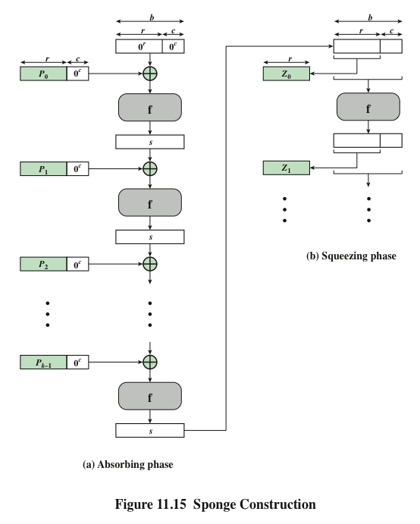
Notes:
Figure 11.15 shows the iterated structure of the sponge function. The sponge
construction operates on a state variable s of b = r + c bits, which is initialized to all
zeros and modified at each iteration. The value r is called the bitrate. This value is
the block size used to partition the input message. The term bitrate reflects the fact
that r is the number of bits processed at each iteration: the larger the value of r , the
greater the rate at which message bits are processed by the sponge construction.
The value c is referred to as the capacity . A discussion of the security implications of
the capacity is beyond our scope. In essence, the capacity is a measure of the achievable
complexity of the sponge construction and therefore the achievable level of
security. A given implementation can trade claimed security for speed by increasing
the capacity c and decreasing the bitrate r accordingly, or vice versa. The default
values for Keccak are c = 1024 bits, r = 576 bits, and therefore b = 1600 bits.

Slide 13
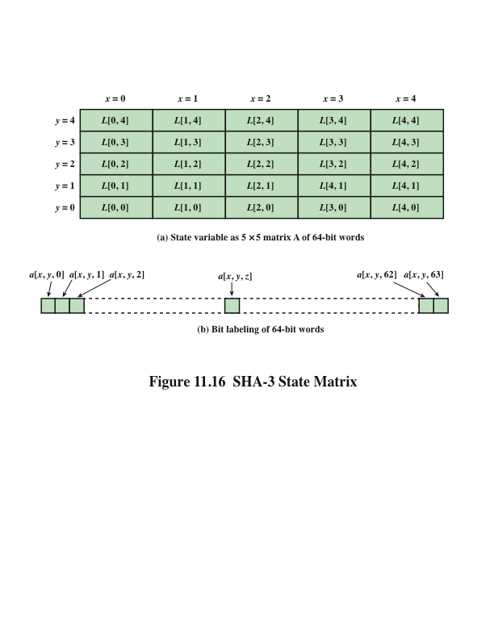
The Iteration Function f of SHA-3
Notes:
We now examine the iteration function Keccak-f used to process each successive
block of the input message. Recall that f takes as input a 1600-bit variable s consisting
of r bits, corresponding to the message block size followed by c bits, referred to as the
capacity. For internal processing within f , the input state variable s is organized as a
5 * 5 * 64 array a . The 64-bit units are referred to as lanes . For our purposes, we generally
use the notation a [x , y , z ] to refer to an individual bit with the state array. When
we are more concerned with operations that affect entire lanes, we designate the
5 * 5 matrix as L [x , y ], where each entry in L is a 64-bit lane. The use of indices
within this matrix is shown in Figure 11.16. Thus, the columns are labeled x = 0
through x = 4, the rows are labeled y = 0 through y = 4, and the individual bits
within a lane are labeled z = 0 through z = 63.
The mapping between the bits of s
and those of a is
s [64(5y + x ) + z ] = a [x , y , z ]
We can visualize this with respect to the matrix in Figure 11.16. When treating
the state as a matrix of lanes, the first lane in the lower left corner, L [0, 0], corresponds
to the first 64 bits of s . The lane in the second column, lowest row, L [1, 0],
corresponds to the next 64 bits of s . Thus, the array a is filled with the bits of s starting
with row y = 0 and proceeding row by row.

Slide 14
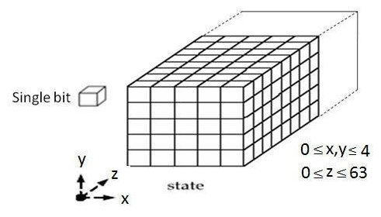
The Iteration Function f of SHA-3
The state: an array of 5 * 5 * 2^ℓ bits (l=6) = 5 * 5 * 64 =1600
The b= 1600 bit state can be viewed as a 3-dimensional array
5×5 lanes (words), each containing 64 bits
Notes:
We now examine the iteration function Keccak-f used to process each successive
block of the input message. Recall that f takes as input a 1600-bit variable s consisting
of r bits, corresponding to the message block size followed by c bits, referred to as the
capacity. For internal processing within f , the input state variable s is organized as a
5 * 5 * 64 array a . The 64-bit units are referred to as lanes . For our purposes, we generally
use the notation a [x , y , z ] to refer to an individual bit with the state array. When
we are more concerned with operations that affect entire lanes, we designate the
5 * 5 matrix as L [x , y ], where each entry in L is a 64-bit lane. The use of indices
within this matrix is shown in Figure 11.16. Thus, the columns are labeled x = 0
through x = 4, the rows are labeled y = 0 through y = 4, and the individual bits
within a lane are labeled z = 0 through z = 63.
The mapping between the bits of s
and those of a is
s [64(5y + x ) + z ] = a [x , y , z ]
We can visualize this with respect to the matrix in Figure 11.16. When treating
the state as a matrix of lanes, the first lane in the lower left corner, L [0, 0], corresponds
to the first 64 bits of s . The lane in the second column, lowest row, L [1, 0],
corresponds to the next 64 bits of s . Thus, the array a is filled with the bits of s starting
with row y = 0 and proceeding row by row.

Slide 15
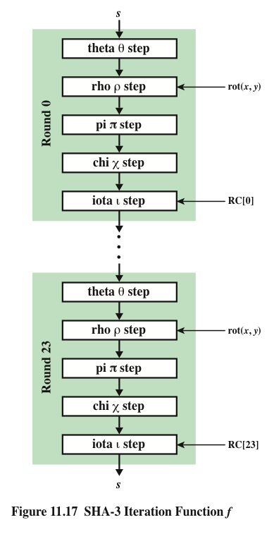
SHA-3
Iteration Function f
Notes:
The function f is executed once for each input block of the message
to be hashed. The function takes as input the 1600-bit state variable and converts
it into a 5 * 5 matrix of 64-bit lanes. This matrix then passes through 24 rounds of
processing. Each round consists of five steps, and each step updates the state matrix
by permutation or substitution operations. As shown in Figure 11.17, the rounds are
identical with the exception of the final step in each round, which is modified by a
round constant that differs for each round.

Slide 16
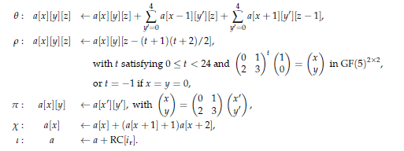
SHA-3 Iteration Function f
Notes:
Figure 11.18.a illustrates the operation on L [3, 2]. The same operation is performed
on all of the other lanes in the matrix.

Slide 17
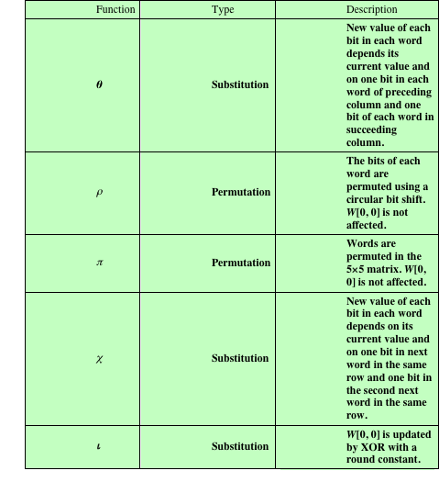
Table 11.6
Step Functions
in SHA-3
Notes:
Table 11.6 summarizes the operation of the five steps. The steps have a simple
description leading to a specification that is compact and in which no trapdoor
can be hidden. The operations on lanes in the specification are limited to bitwise
Boolean operations (XOR, AND, NOT) and rotations. There is no need for table
lookups, arithmetic operations, or data-dependent rotations. Thus, SHA-3 is easily
and efficiently implemented in either hardware or software.

Slide 18
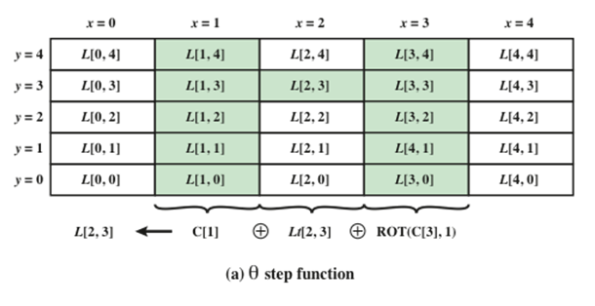
Theta step Function
C[x]=L[x,0] XOR L[x,1] XOR L[x,2]
XOR L[x,3] XOR L[x,4]
Each of the 1600 state bits is replaced by the XOR result of 11 bits
the 5-bit column “to the left” of the bit
the 5-bit column “to the right” and “1 position to the front” of the bit.
Notes:
Figure 11.18.a illustrates the operation on L [3, 2]. The same operation is performed
on all of the other lanes in the matrix.

Slide 19
Rho step and Pi step
Rho: a[x,y,z] ← a[x,y,z], if x=y=0
Rho: a[x,y,z] ← a[x,y,(z – (t+1)(t+2)/2)], 0=<t<=23,
And
t
1
x
0 1
( )
( )
( )
=
2 3
0
y
x=0
x=1
x=2
x=3
x=4
y=4
18 | 2 | 61 | 56 | 14
41 | 45 | 15 | 21 | 8
3 | 10 | 43 | 25 | 39
36 | 44 | 6 | 55 | 20
0 | 1 | 62 | 28 | 27
y=3
y=2
y=1
y=0
Notes:
Figure 11.18.a illustrates the operation on L [3, 2]. The same operation is performed
on all of the other lanes in the matrix.

Slide 20
Rho step and Pi step
Rho: a[x,y,z] ← a[x,y,z], if x=y=0
Rho: a[x,y,z] ← a[x,y,(z – (t+1)(t+2)/2)], 0=<t<=23,
Rho step operates on words of length 64 bits (can be stored in a register)
Input: A[x,y], x, y =0,1,2,3,4
Output: B[x,y]
Rho-step: Rotate -- each word is rotated by a fixed number of positions
Z[x,y] = rotate (A[x,y], r[x,y]): Here r[x,y] is table entries.
Pi step: Permutate the rotated words.
B[y,2x+3y] = Z[x,y], x, y =0,1,2,3,4
Notes:
Figure 11.18.a illustrates the operation on L [3, 2]. The same operation is performed
on all of the other lanes in the matrix.

Slide 21
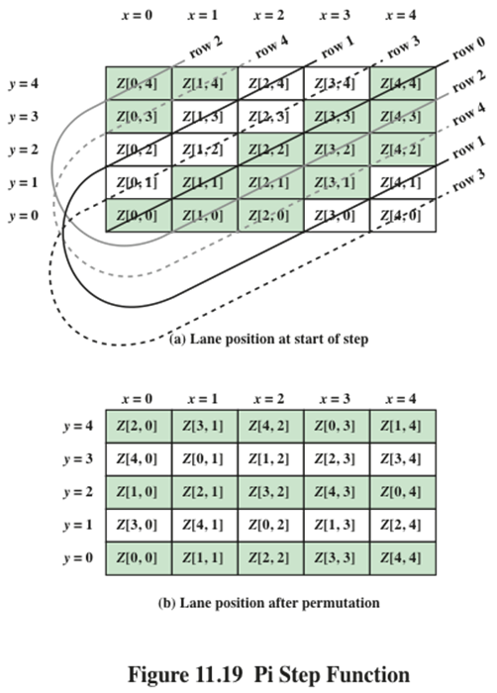
Pi step Function
Pi: a[x,y] ← a[x’,y’]
x
0 1
x’
( )
( )
( )
=
2 3
y’
y
Notes:
Figure 11.18.a illustrates the operation on L [3, 2]. The same operation is performed
on all of the other lanes in the matrix.

Slide 22
Rho step and Pi step: Example
Rho step:
Example: Input word A[3,1]
Rho step: Z[3,1] = rot (A[3,1], 55)
Pi step:
B[1, 2*3+3*1 mod 5] = B[1,4] =Z[3,1]
Notes:
Figure 11.18.a illustrates the operation on L [3, 2]. The same operation is performed
on all of the other lanes in the matrix.

Slide 23
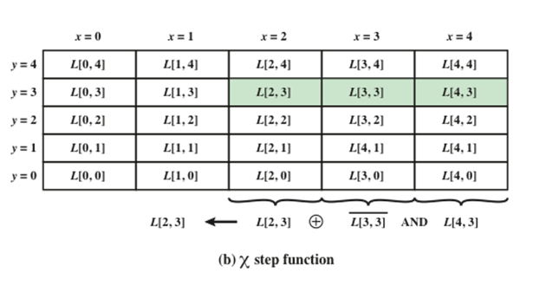
Chi step Function
Chi step: is a nonlinear mapping step, combining the row elements using only three logic operators, AND, NOT, and XOR
Input: B[x,y]
Output: S[x,y]
S[x,y] = B[x,y] XOR (B’ [x+1,y] AND B[x+2,y]
S[x,y,z] = B[x,y,z] XOR (B’ [x+1,y,z] AND B[x+2,y,z]
Notes:
Figure 11.18.a illustrates the operation on L [3, 2]. The same operation is performed
on all of the other lanes in the matrix.

Slide 24
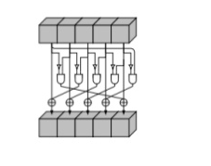
Chi step Function
Chi step: is a nonlinear mapping step, combining the row elements using only three logic operators, AND, NOT, and XOR
Input: B[x,y]
Output: S[x,y]
S[x,y] = B[x,y] XOR (B’ [x+1,y] AND B[x+2,y]
S[x,y,z] = B[x,y,z] XOR (B’ [x+1,y,z] AND B[x+2,y,z]
Notes:
Figure 11.18.a illustrates the operation on L [3, 2]. The same operation is performed
on all of the other lanes in the matrix.

Slide 25
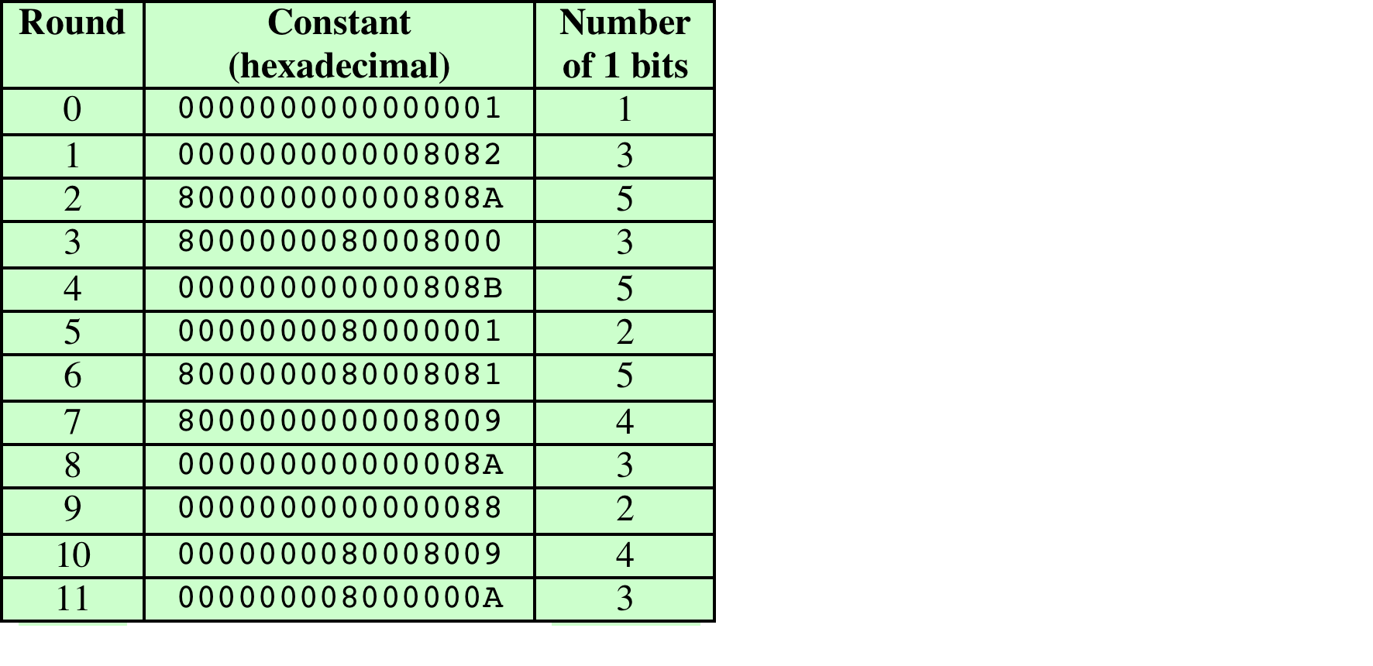
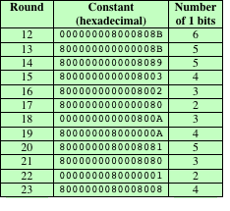
Iota step Function
Iota step: Add constants from constant table to word A[0,0]
L[0,0]=L[0,0] XOR RC[ir], 0=<ir<=23
Notes:
Figure 11.18.a illustrates the operation on L [3, 2]. The same operation is performed
on all of the other lanes in the matrix.

Slide 26
Summary
have considered:
  hash functions
    uses, requirements, security
  hash functions based on block ciphers
  SHA-1, SHA-2, SHA-3
Notes:
Chapter 11 summary.

